Slide 1

Annual Public Budget Meeting
September 18, 2023
Office of the Chief Financial Officer
Office of Budget
Notes:
All font should be Montserrat
Text within content blocks should be 12pt font
To edit Department in the lower right corner, click Slide, Edit Master. In top “Master” slide edit Department name in footer

Slide 2
Agenda
Welcome and Introductions
City of Detroit Office of Budget
Department Presentations
  General Services Department
  Department of Public Works
  Water and Sewerage Department
Public Comment

Slide 3
How is the budget built?
Sept
Budget Kickoff
Sept
Sept. Revenue Estimating Conference
The City’s fiscal year (FY) runs from July 1 to June 30
    FY 2024:
    July 1, 2023 to June 30, 2024
    FY 2025:
    July 1, 2024 to June 30, 2025
Sept – Oct
Annual Public Budget Meetings
Oct
District Priorities Forums
Nov – Feb
Budget Preparation
Feb
Feb. Revenue Estimating Conference
Mar
Mayor Proposes Budget
Mar – Apr
City Council Budget Hearings
Apr
City Council Adopts Budget
Jul 1
Fiscal Year Begins
= opportunities for public input

Slide 4
Where does the budget money come from?
Detroit’s FY24 city budget totals $2.6 billion
Revenue sources that support the General Fund include: Wagering Tax, Property Tax, Income Tax, Utility Users Tax, and State Revenue Sharing
The “Other” category includes: court fines & fees, parking fines & fees, licenses, permits, inspections, and emergency medical services fees​

Slide 5
Where does the budget money go?
The City’s expenditures exactly equal its revenues to maintain a balanced budget
The FY24 budget supports approximately 10,800 full-time equivalent (FTE) positions
The FY24 budget supports an increase of 288.5 FTE positions, supporting departments like health, general services, and water and sewer
Notes:
Largest category:​
Water & sewer, DPW, GSD, Construction & Demo​
Department breakouts can be found in our Budget in Brief handout​
Enterprise agencies include:​
DDOT​
Airport​

Slide 6
What portion of the budget can we influence?
FY24 Adopted Budget – General Fund ($1.3 billion)
FY24 Adopted Budget – All Funds ($2.6 billion)

Slide 7
Ways to #TakePart in Your Budget
Email us any time at
Attend the Annual Public Budget Meetings – tune in on September 18th & September 25th @5pm (see next slide for joining information)
  Learn more about the budget cycle and hear from several city service, health, and safety departments
Attend your District Priority Forum – tune into your regular DON meeting from mid-to-late October (see next slide for schedule)
  Share what you would prioritize within the budget
Look for more information at
YourBudget@detroitmi.gov
Detroitmi.gov/Budget

Slide 8
Annual Public Budget Meetings
EVENT | JOINING INFORMATION | DEPARTMENTS PRESENT
Annual Public Budget Meeting Part 1: General City Service Departments | September 18th @5pm Join via Zoom: https://cityofdetroit.zoom.us/j/85997730698 Join via Phone: (313) 626-6799 Meeting ID: 859 9773 0698 | General Services Department (GSD) Department of Public Works (DPW) Water & Sewerage Department (DWSD)
Annual Public Budget Meeting Part 2: Public Health & Safety Departments | September 25th @5pm Join via Zoom: https://cityofdetroit.zoom.us/j/3631409738 Join via Phone: (313) 626-6799 Meeting ID: 859 9773 0698 | Public Lighting Department (PLD) / Public Lighting Authority (PLA) Fire Department (DPD) Health Department (DHD) Police Department (DPD)

Slide 9
District Priorities Forums
Call-In Number:
(312) 626-6799
DISTRICT | DETAILS | Joining Info
1 | October 26th @5:30pm | Crowell Recreation Center / hybrid https://cityofdetroit.zoom.us/j/92945572636 Meeting ID: 929 4557 2636
2 | October 10th @6pm | Northwest Activities Center / hybrid https://cityofdetroit.zoom.us/j/85890565831 Meeting ID: 858 9056 5831 Passcode: 222222
3 | October 24th @6pm | https://cityofdetroit.zoom.us/j/93947894155 Meeting ID: 939 478 94155
4 | October 24th @5pm | https://cityofdetroit.zoom.us/j/89532011115 Meeting ID: 895 3201 1115
5 | October 18th @6pm | https://cityofdetroit.zoom.us/j/88093600136 Meeting ID: 880 936 00136
6 | October 19th @5pm | https://cityofdetroit.zoom.us/j/3631409738 Meeting ID: 363 140 9738
7 | October 25th @5pm | https://cityofdetroit.zoom.us/j/89283928278 Meeting ID: 892 839 28278

Slide 10
General Services Department (GSD)

Slide 11
General Services Department
Mission
Mission of GSD
The General Services Department provides leadership and best practices to improve city services by ensuring the resources are deployed strategically and proactively to provide support services to elected officials, City departments, and residents in a safe, reliable, and efficient manner.
Notes:
Information copied from Annual Public Budget Meeting 2020 slides

Slide 12
General Services Department
Services & Activities
Services | Activities
Animal Care and Control | Promote & protect the health, safety, and welfare of the residents & visitors of the City of Detroit from animal bites, zoonotic disease, and traffic hazards; to maintain the highest standards of humane animal sheltering; to promote the placement of animals into homes; and to encourage responsible pet ownership through education and enforcement.
Blight Remediation | Transforming our City from Blight to Beauty for the health, safety, and dignity of our residents.
Building Services | Maintain and clean facilities and public spaces to promote health, safety, and creating a pristine environment.
Fleet Management | Deliver the best service to our customer departments by providing timely, safe, reliable, economical, and environmentally responsible transportation.
Grounds Maintenance | Provides high quality services that delight neighboring communities with maintaining our impeccable parks and public spaces.
Landscape Design and Beautification | Design, plan, and implement public space improvements that meet community needs, adds beauty and color
Recreation Programs | Connecting communities, residents, and visitors with our parks, programs, and recreation facilities to address five key areas for a healthy community: Aquatics, Athletics, Critical Needs, Enrichment, and Nature.

Slide 13
General Services Department
Budget by Service
Services | FY 2024 Adopted | FY 2024 Adopted FTE
Animal Care and Control | $7,493,264 | 96.5
Blight Remediation | $30,431,543 | 324.0
Building Services | $40,452,290 | 191.0
Fleet Management | $17,559,512 | -
Grounds Maintenance | $8,950,423 | 8.0
Landscape Design and Beautification | $7,815,770 | 42.0
Recreation Programs | $24,206,050 | 258.6
Total: | $136,908,852 | 920.1

Slide 14
General Services Department
Capital Projects & New Initiatives
Dead, Dangerous, Diseased Tree Removal Project – New Initiative
  In April we launch the D3 tree removal program to remove dead, dangerous, & diseased trees from private properties.
Freeway Maintenance Project – New Initiative
  The City has been granted maintenance oversight of the five freeways in the city. Our area of responsibility is mowing and litter pick-up of the slopes or grass area.
Parks, Public Spaces, & Recreation Capital Project
  Five year parks & Recreation Improvement Plan which includes the Joe Louis Greenway.
Vehicle Replacement Plan – Capital Project
  Maintain the vehicle replacement schedule, enforce preventative maintenance schedule and right size fleet with zero – low emissions options.

Slide 15
General Services Department
How We Measure Success
Metrics | Data
Alleys Cleared | 2,529 alleys
Murals Completed | 118 murals
Corridor Jobs Completed | 4,290 corridors
Monthly Dog Bites | 46 dog bites
Buildings Painted | 322 buildings

Slide 16
General Services Department
Contact Information
General Services Department
        115 Erskine, Detroit, MI 48201
        313-224-1100
https://detroitmi.gov/departments/general-services-department

Slide 17
Department of Public Works (DPW)

Slide 18
Department of Public Works
Mission
Mission of DPW
MISSION is to provide excellence in the delivery of essential environmental and infrastructure services, thereby ensuring a safe and clean environment for our residents and visitors in a cost-effective manner.
DPW’s core deliverables will include enhanced trash collection, road paving, snow removal, maintenance of traffic signs and signals, as well as constructing streets in a manner that provides for safe travel for all users of the public right of way.

Slide 19
Department of Public Works
Services & Activities (part 1)
Services | Activities
Admin / Overhead | Oversee all department operations
Accessibility | Will construct ADA compliant ramps as part of road paving projects
Bulk waste collection | Frequency of bulk collection increases to weekly
Complete Streets right of way design | New streetscape on Dexter Avenue will be constructed in 2024; all roads are designed in manner that is safe for pedestrians and vehicles; 57,000 ADA compliant handicap ramps have been installed at citywide.
Construction & right of way permits | Our City Engineering Division issues 1400 permits annually for companies and utilities to access and perform work in the public right of way
Dead animal removal | DPW removes dead animals, upon notification, from public roads and the front of private properties
Illegal dumping & disposal | DPW crews remove over 30,000 tons of illegally dumped and set out debris annually
Maps & records | Our City Engineering Division maintains all maps and records for all assets in the public right of way, including roads, bridges, etc.
Paid pickup requests | Upon request, DPW will conveniently remove bulky items from the properties at a nominal cost
Paving roads & streets | DPW will repave 60+ miles of major and local roads with this budget
Pothole repair | Streets Division will repair potholes within 3 days of being notified of existence
Recycling collection | Recycling collections will be increased to weekly for all households that have opted into our curbside recycling program

Slide 20
Department of Public Works
Services & Activities (part 2)
Services | Activities
Right of way design review & construction inspection | City Engineering Division performed 766 right of way plan design reviews and performs over 1000 right of way inspections annually
Sidewalks | Current budget provides for replacing 70,000 flags of sidewalk citywide; city, at minimum, is responsible for sidewalk damaged by a city tree
Sign shop | Our street funded Sign Shop fabricates and installs all of the traffic and parking signs throughout the city, including stop sign, no parking signs, etc.
Solid waste & refuse collection | Our Solid Waste Division manages all solid waste services, including the curbside collection of weekly trash, bulk, yard waste, and recycling. In addition, city crews clean illegally dumped and setout debris citywide.
Snow & ice removal | Major roads are salted and plowed as needed after all snow and ice events; residential streets are plowed by contractors when we receive a snowstorm of 6 inches or more.
Speed hump program | At the request of residents, over 10,000 speed humps have been installed to dramatically reduce speeding on residential streets

Slide 21
Department of Public Works
Services & Activities (part 3)
Services | Activities
Street sweeping | Residential streets are swept twice per year; major roads are swept at least once per month
Traffic control devices | DPW manages and maintains nearly 800 city jurisdiction traffic signals, several of which have cameras and technology that allow for remote monitoring and control
Traffic management center | Our TMC is our nerve center, where traffic can be monitored in real time, and adjustments can be made based on real time conditions.
Viaduct public area maintenance | DPW removes debris and shrubbery from the city’s 126 viaducts at least twice per year
Waste disposal (GDRRA) | The Greater Detroit Resource Recovery Authority (GDRRA) manages the disposal and processing of all solid waste in the city, including trash, bulky waste, compostables, and recyclable materials.
Yard waste collection | Yard waste will be collected weekly from the front of household from the beginning of April through the end of December.

Slide 22
Department of Public Works
Budget by Service (part 1)
Services | FY 2024 Adopted | FY 2024 Adopted FTE
Admin / Overhead | $9,765,543 | 13.0
Accessibility | $2,699,936 | 9.0
Bulk waste collection | $4,514,087 | 4.0
Complete Streets right of way design | $504,887 | 4.0
Construction & right of way permits | $2,573,798 | 30.25
Dead animal removal | $386,074 | 2.0
Illegal dumping & disposal | $4,254,461 | 66.5
Maps & records | $1,501,093 | 9.0
Paid pickup requests | $1,188,131 | 13.0
Paving roads & streets | $43,931,417 | 50.0
Pothole repair | $6,076,201 | 27.0
Recycling collection | $5,413,401 | 9.5

Slide 23
Department of Public Works
Budget by Service (part 2)
Services | FY 2024 Adopted | FY 2024 Adopted FTE
Right of way design review & construction inspection | $8,296,884 | 38.0
Sidewalks | $2,960,686 | 17.0
Sign shop | $3,645,170 | 42.0
Solid waste & refuse collection | $16,301,217 | 10.0
Snow & ice removal | $7,384,379 | 32.0
Speed hump program | $3,264,156 | 24.5
Street sweeping | $5,703,487 | 41.0
Traffic control devices | $6,327,817 | 29.0
Traffic management center | $1,528,269 | 2.5
Viaduct public area maintenance | $1,410,989 | 15.0
Waste disposal (GDRRA) | $14,043,333 | 4.0
Yard waste collection | $4,514,087 | 4.0
Total: | $154,435,022 | 496.25

Slide 24
Department of Public Works
Capital Projects & New Initiatives
Weekly Collection of Bulk, Yard Wastes, and Recyclables (New Initiative)
Road Infrastructure Improvements (Capital Project)
  Improve the condition of over 60 miles of city roads through resurfacing or reconstruction
Dexter Ave. Streetscape (Capital Project)
  A new, beautiful safer corridor will include new road, street lighting, street furniture along Dexter, between Webb and Davison
Safety Improvements to Reduce Serious and Fatal Accidents on City Streets (New Initiative)
  Grant funded program will provide for safety improvements to be implemented on 31 miles of roads with the highest volume of crashes

Slide 25
Department of Public Works
How We Measure Success
Metrics | Data
Illegally Dumped Trash Removed – Minimum 600 tons/week | Average of 700 tons/week
% of Pothole Complaints Addressed within 3 Days | 98% closed out within 3 days
Pave 65 miles of roads citywide in 2023 | 45 miles completed to date
Restore malfunctioning traffic signals with 48 hours | 90% of signals, with power, are restored within 2 days

Slide 26
Department of Public Works
Contact Information
Ron Brundidge, Director
Oladayo Akinyemi, Deputy Director
Richard Doherty, City Engineer
James Hannig, Deputy Director of Complete Streets
www.detroitmi.gov/dpw
(313) 224-3901

Slide 27
Detroit Water & Sewerage Department (DWSD)

Slide 28
DWSD
Mission
Mission of DWSD
The Water and Sewerage Department (DWSD) strives to exceed our customers’ expectations through the efficient distribution of treated water, collection of wastewater for treatment and the provision of services that promote healthy communities and economic growth.

Slide 29
DWSD
Services & Activities
Services | Activities
Water Distribution | Provide delivery of potable water for more than 230,000 customers. Deliver potable water at adequate pressure to meet our customers’ needs. Provide water that meets or exceeds standards as required by Michigan’s Safe Drinking Water Act as well as federal standards. Furnish sufficient water pressure and service to ensure acceptable fire protection for commercial buildings and schools. Maintain the nearly 30,000 fire hydrants throughout our city.
Wastewater Collection | Convey sanitary and combined sewage collected throughout the service area to the Great Lakes Water Authority (GLWA) operated facilities. Maintain and upgrade the Detroit Local System and serve as first responder for necessary repairs occurring within Detroit. Serve as the retail advocate for Detroit-based constituents (Detroit Retail Class), including households, businesses, non-profits, and faith-based organizations, in the procuring of water and sewerage services from GLWA. Serve as the collection agent for the Detroit Retail Class.

Slide 30
DWSD
Budget by Service
Services | FY 2024 Adopted | FY 2024 Adopted FTE
Water Distribution | $244,744,200 | 650.0
Wastewater Collection | $387,942,900 | 28.0
Total: | $632,687,100 | 678.0

Slide 31
DWSD
Capital Projects & New Initiatives
DWSD FY 24 Capital Projects:
$64.7 Million for water main replacement and other related upgrades
$20.7 Million for sewer main replacement and other related upgrades
$8.9 Million for Green Stormwater Infrastructure installations
$7.6 Million for automatic water meter reading system and meter replacement
$2.5 Million for fire hydrant replacement
$31 Million for lead service line replacement

Slide 32
DWSD
How We Measure Success
DWSD Lifeline Plan is Detroit’s income-based water affordability program
Protected From Shut Off | Households
Lifeline Enrolled | 23,309
10/30/50 Payment Plan | 2,581
Lifeline Applications Pending Approval | 173
 | 26,063
This data is as of September 6, 2023

Slide 33
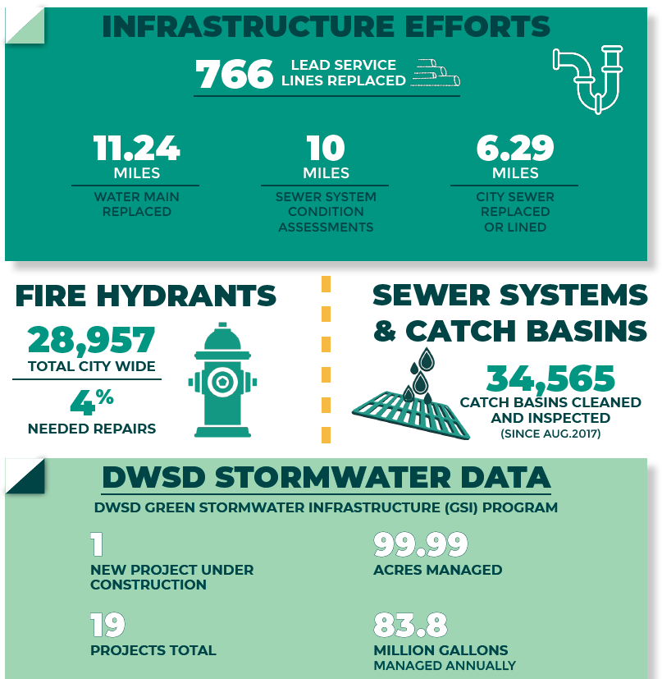
DWSD
How We Measure Success
This data is for calendar year 2022.

Slide 34




DWSD
Contact Information
FOLLOW US!
Facebook.com/DWSDDetroit
Customer Service: 313-267-8000
DWSD website
https://detroitmi.gov/DWSD
@DetroitWaterDep
YouTube.com/DWSDwater

Slide 35
Questions?
Moderated Public Comment:
“Raise Hand” function in Zoom
Share more by emailing:
YourBudget@detroitmi.gov
Notes:
All font should be Montserrat
Text within content blocks should be 12pt font
To edit Department in the lower right corner, click Slide, Edit Master. In top “Master” slide edit Department name in footer

