Slide 1

City of Detroit
Detroit Alerts 365 (CodeRED)

Slide 2


Slide 3
Key Capabilities & Features
Immediate and simultaneous alerts to voice, text, email, social media and mobile app
Foreign Language Message Translation
(English, Arabic, Spanish and Bangla)
Geo-Target: Send alerts based on location

Slide 4


Slide 5
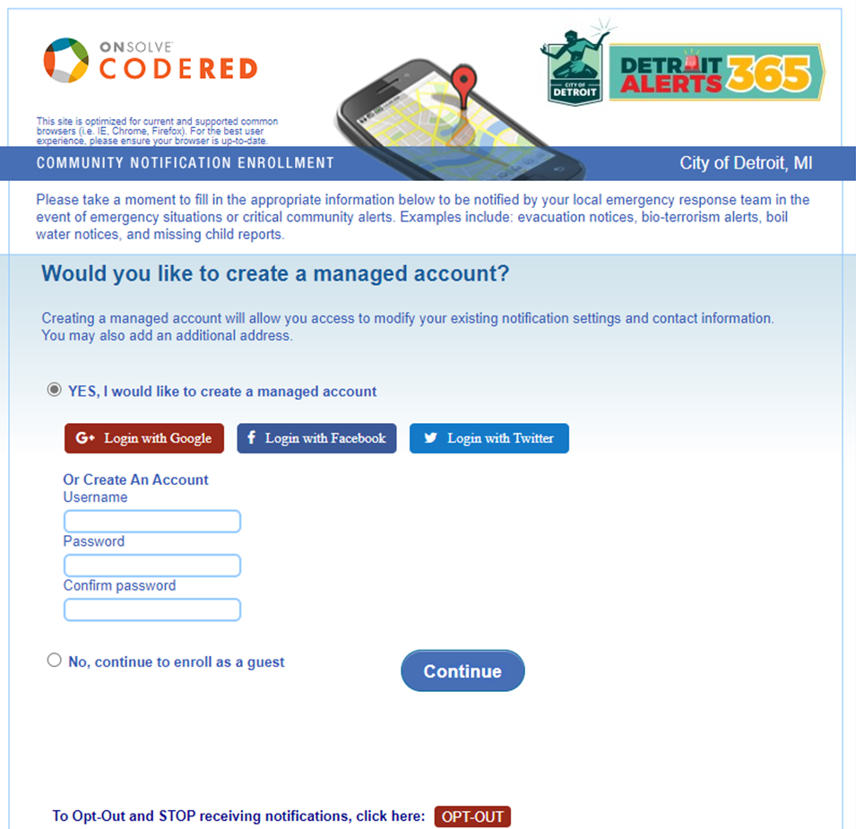
City of Detroit
Landing Page
This is the enrollment page that individuals will see when they enter the opt-in page.

Slide 6
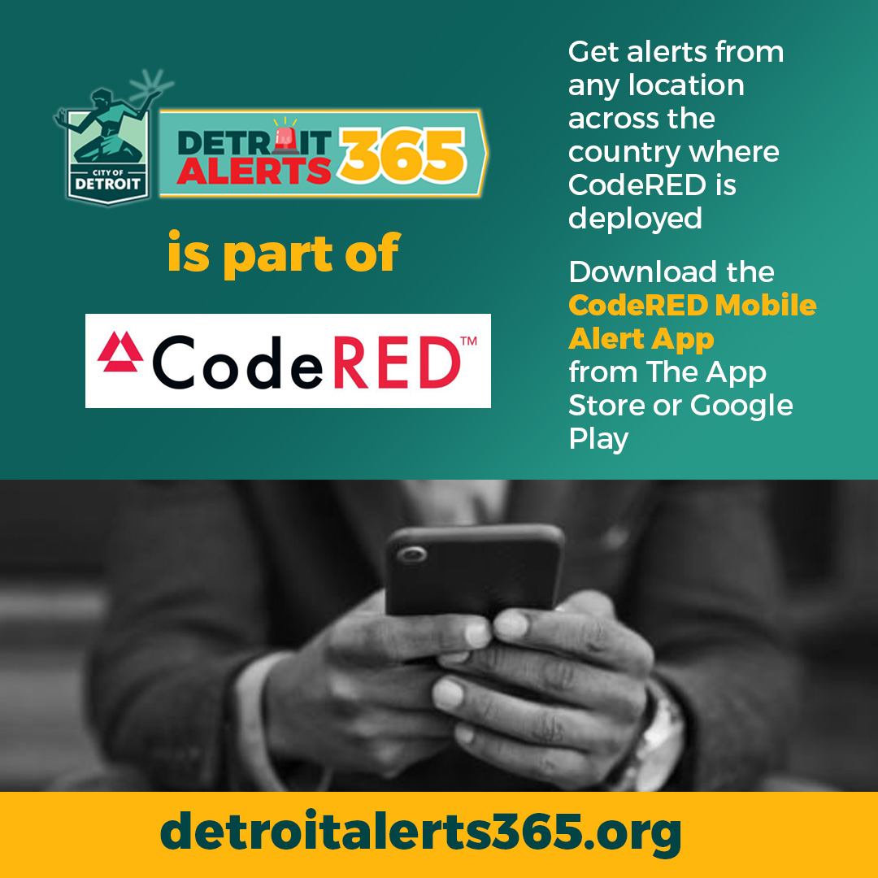

Slide 7
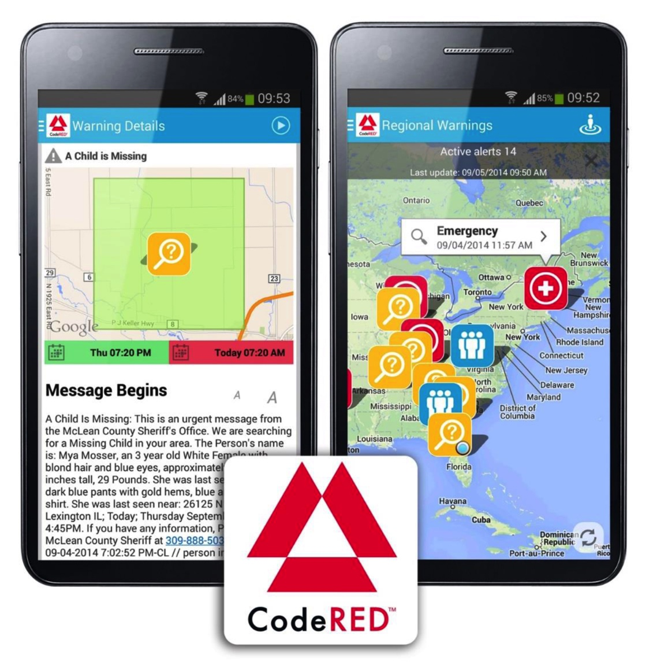
CodeRED Mobile Alert App
Emergency messages delivered directly to residents, visitors, and commuters who need to take immediate action
Location-based mobile device notification app
Message includes audio, text and map
Easily implemented for special events
Geo-Target audience on mobile devices

