Slide 1

District 1 community meeting
Commissioner Bryan Ferguson, Vice-Chairperson, District 1
Commissioner Annie Holt, Immediate Past Vice-Chairperson, At-Large
Saturday, February 26, 2022

Slide 2
BOPC’s Key Charter Mandates
Sec. 7-803. Of Detroit City Charter: Duties of the Board of Police Commissioners
BOPC:
In consultation with the Chief of Police, and with the approval of the Mayor establishes policies (I.e. Facial Recognition Policy and Use of Force), rules, and regulations.
Reviews and approves the DPD budget before it is submitted to the Mayor.
Receives and resolves complaints concerning the operation of the DPD and forward all allegations of criminality to the appropriate internal or external law enforcement agency for further investigation.
Acts as final authority in imposing or reviewing discipline of employees of DPD.
Makes an annual report to the Mayor, the City Council, and the public of the department’s activities during the previous year, including the handling of crime and complaints, and of future plans.
May subpoena witnesses, administer oaths, and take testimony.

Slide 3
RESPONSIBILITIES AND CULTURE OF
DETROIT BOARD OF POLICE COMMISSIONERS
“Accountability through Civilian Oversight”
The Board of Police Commissioners has supervisory control and oversight of the Police Department as set forth in the Detroit City Charter since 1974.
BOPC is composed of eleven members, seven of whom are elected; four members are appointed by the Mayor and subject to approval of the City Council.
Appointed members serve a term of five years.
The Mayor can remove an appointee for cause.
All members of the Board must be residents of the City of Detroit.
BOPC meets every Thursday of the month with the exception of Christmas and Thanksgiving Holidays; all meetings are held at the DPD Headquarters with the exception of the second Thursday, which is held in the community.

Slide 4
2022 Goals and Objectives

Slide 5
2022 Goals and Objectives
Support the BOPC Resolution for Detroit’s leadership and community success on President Obama’s Goals for 21st Century community policing.
Continue enhancing DPD’s policies and procedures by ensuring that Detroit aligns with safe, appropriate, and legitimate 21st Century Policing and Public Safety Measures.
Hold bi-annual or quarterly forums to increase community involvement and engagement on public safety, crime reduction, and civilian oversight (I.e. Youth Advisory Councils, Gun Reduction Backlog Project, Public Safety Measures)
Work to enhance local Recruitment and Retention practices toward bolstering law enforcement and policing as a viable career option (I.e. Administration, Technology, Legal).
Enhance DPD Training Curriculum for continuity between policy and implementation.
Recommend / Enhance Key Areas of the Detroit City Charter to ensure independent civilian oversight measures meet the challenges and needs of the modern era.

Slide 6
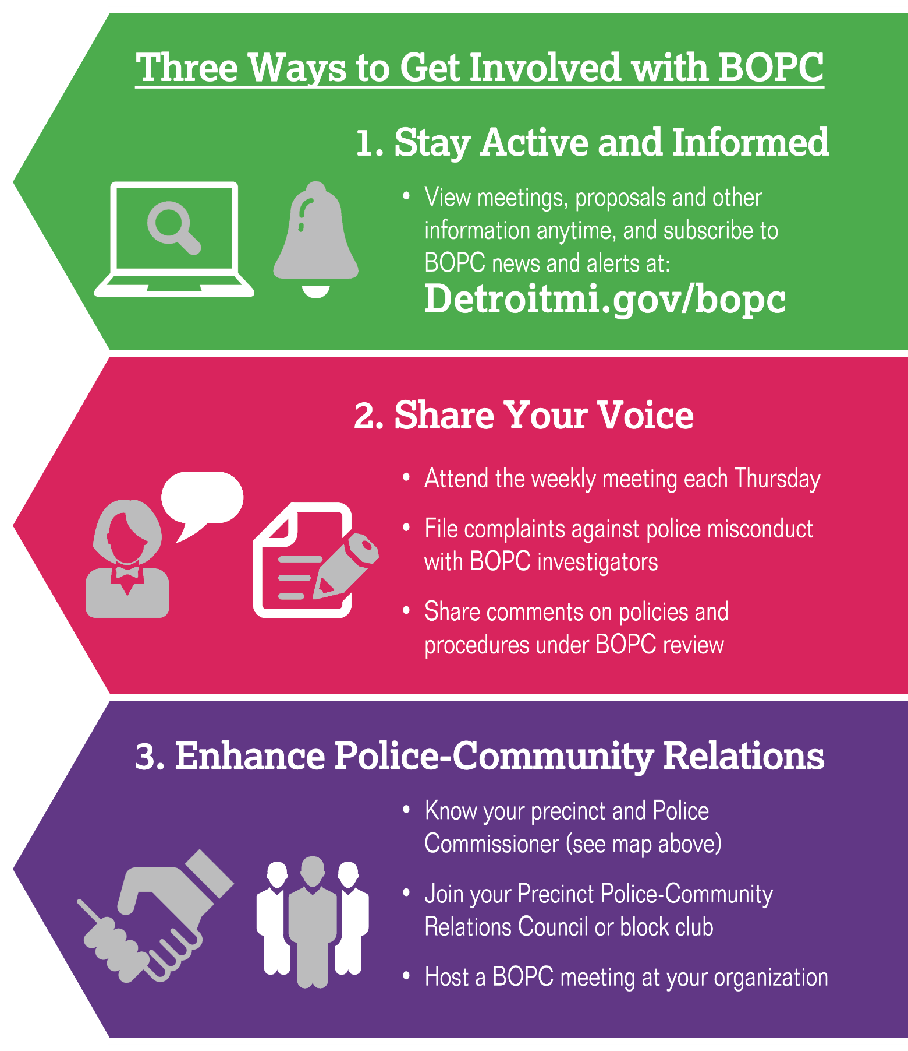
Get Connected. Stay Engaged
Board meets each Thursday
BOPC Contact Information:
Administration
313.596.1830 bopc@detroitmi.gov
Complaint Investigations
Office of the Chief Investigator [non-criminal complaints]
24-Hour Complaint Line: 313.596.2499
Telefax: 313.596.2482
Website: detroitmi.gov/bopc

Slide 7
QUESTIONS?

