Slide 1



DIRECTOR’S REPORT
December 15, 2021

Slide 2
CONTENTS*
Metrics by Function:
• Director’s Message 3
• Customer Care 4
• Field Services 7
• Finance 12
• Legal Services 15
• Investigations 17
• Human Resources 19
• Public Affairs 22
• Information Technology 25

Slide 3

DIRECTOR’S MESSAGE TO THE BOARD
In November, the Detroit Water and Sewerage Department (DWSD) launched a new customer education campaign with a focus on the small things residents can do, while the department’s employees continue working hard to maintain and upgrade the water and sewer systems.
The advertising campaign will run through the winter on billboards, radio, cable television, streaming services, social media, websites where most Detroiters frequently visit, and the Michigan Chronicle (print ad shown at right). The small things include cleaning catch basins of leaves, dirt and trash, dumping fat, oil and grease in a disposable container instead of into a sink drain, and disconnecting downspouts and rerouting them onto lawns – steps that can help reduce flooding and backups.
The TV and streaming commercial can be viewed here: https://youtu.be/9CA6YNims-s.

Slide 4


Customer Service

Slide 5
CUSTOMER SERVICE: Number of Active Accounts
Active Residential Accounts Active Non-Residential Accounts
Vacant parcels, parking lots and other properties with no need for water service, receive stormwater charges only (drainage).

Slide 6
CUSTOMER SERVICE: Transactions
Number of Transactions
Millions of Dollars
DWSD continues to adapt during the COVID-19 Pandemic and is offering more services remotely, including contact via email at mydwsd@detroitmi.gov. DWSD is also communicating the convenient, safe ways to pay and how customers can access their account(s).

Slide 7
Field Services

Slide 8
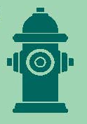
FIELD SERVICES: Fire Hydrant Maintenance
n Operating Fire Hydrants n Operating Hydrants with Issues n Non-Operating Hydrants
DWSD prioritizes fire hydrant maintenance as a key component of providing essential and exceptional service delivery led by the Maintenance & Repair Service Line in our Operations Group. During the Fall season, Detroit Fire Department staff conduct inspections and share the data through a dashboard with DWSD if hydrants need to be repaired or replaced. The community can report hydrant issues via the Improve Detroit mobile app.

Slide 9
FIELD SERVICES: Running Water
n Reported by Customers n Resolved within Two Days
DWSD Operations continues to prioritize these work orders based on level of severity, including number of customers affected, to determine priority.

Slide 10
FIELD SERVICES: Water Main Breaks
n Reported by Customers n Resolved within Four Days
DWSD Operations continues to prioritize these work orders based on level of severity, including number of customers affected, to determine priority.

Slide 11
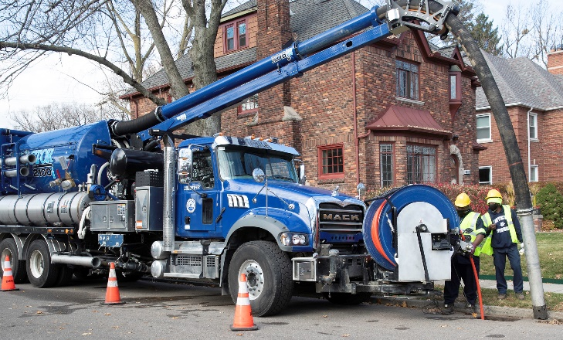
FIELD SERVICES: Catch Basin Inspection & Cleaning
DWSD is expanding sewer cleaning for preventative maintenance to help reduce street flooding and basement backups. As of this report, crews have cleaned 479 miles of city sewer pipe in calendar year 2021 compared with 59 miles in calendar year 2020.

Slide 12
Finance

Slide 13
FINANCE: Bill Collection Rate
April May June
3-Month Rolling Average Collection Rate
n Water Revenue n Sewer Revenue
The Finance data is provided based on the most recent month reported to the Finance Committee of the Board of Water Commissioners.

Slide 14
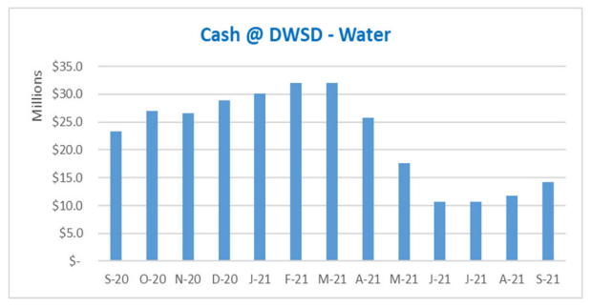
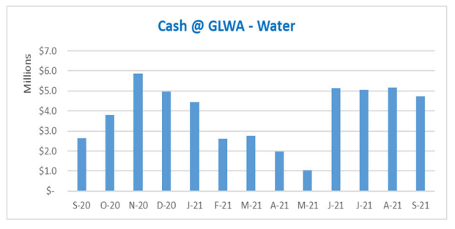
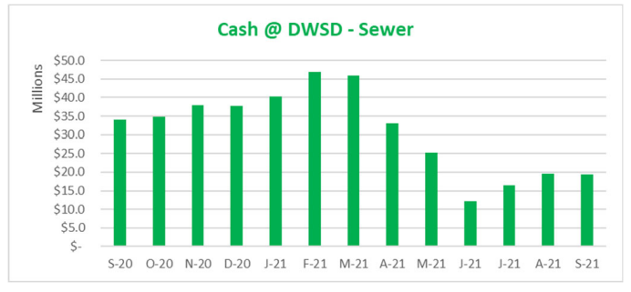
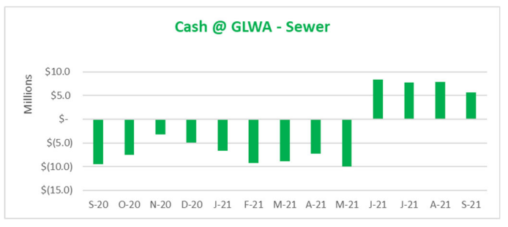
FINANCE: Cash Balance
The Finance data is provided based on the most recent month reported to the Finance Committee of the Board of Water Commissioners.

Slide 15
Legal Services

Slide 16
LEGAL: Claims, Hearings and Cases
27
Cases handled by in-house staff
8
Cases handled by outside counsel
2
Lawsuits dismissed
10
Lawsuits dismissed in calendar year 2021
187
Pending Billing Disputes
56
Disputes Closed in
November 2021
$489,623.19
Total Amount Disputed
$51,780
Total Credits to Customers
54
Total Resolved Utilizing Leak Policy
N/A
Property damage claims
N/A
Damage claims approved
N/A
Amount in property damage claims
N/A
Amount of total claims recommended to be paid
DWSD uses a mix of in-house and contracted legal counsel to handle damage claims, civil action for commercial delinquencies and lawsuits filed against the department.

Slide 17
Investigations

Slide 18
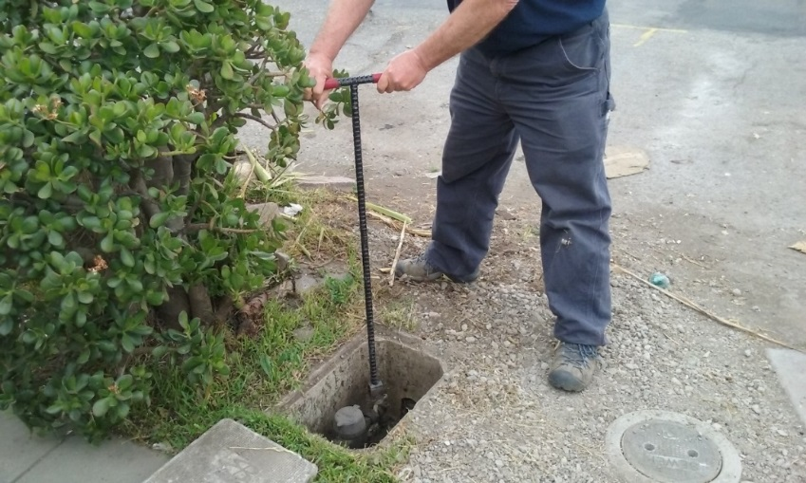
INVESTIGATIONS: Results
Money Owed to DWSD identified by Investigators
$1,274,655
Total since July 1, 2021
$174,354
Back billed
$382,261
Future owed in 12 months
$718,040
Water loss
215
Parcels investigated for delinquency, possible meter tampering and no meter since July 1, 2021
Revenue Identified Since Investigation Unit Began
$20,404,545
Total since August 14, 2017
Since August 2017, the unit, in collaboration with customer service/billing, has identified more than $20 million in services owed by primarily commercial customers. They uncover severe delinquencies, non-working meters, unauthorized use of fire hydrants, meter tampering, or connected to the city’s water main without a meter and/or permit. The unit works closely with the Finance/Collections and Legal Groups.

Slide 19
Human Resources

Slide 20
HUMAN RESOURCES: Detroit Residents and Hiring
Total of 545 DWSD employees, 54% of which live in Detroit.*
*DWSD and the City of Detroit do not require residency to be employed, per Michigan law.

Slide 21
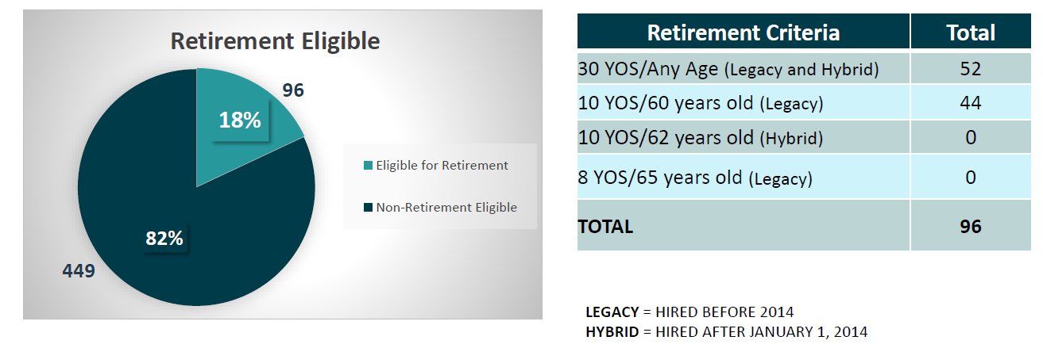
HUMAN RESOURCES: Retirement Eligible
With a current population of 545 employees, there are 96 DWSD employees eligible for retirement.

Slide 22
Public Affairs

Slide 23
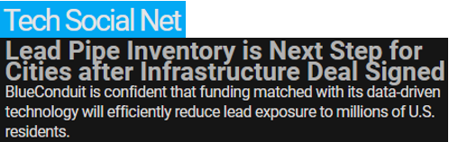
PUBLIC AFFAIRS: Positive vs. Negative News Stories
DWSD News Coverage: November 1 – November 30, 2021
In November, the DWSD Public Affairs team saw a total of 157 media stories. One was negative. The 14 positive stories were about the DWSD and BlueConduit partnership, to save an estimated $165M by using predicative modeling to determine lead service line inventory in Detroit to meet the Michigan Lead and Copper Rule. Majority of the neutral stories were about the Detroit Mayoral Election results and the Flint Water Crisis settlement.
PLEASE NOTE: For this metric, each story/interview published or aired is counted.

Slide 24



PUBLIC AFFAIRS: Social Media Activity
1
New Facebook Followers
8,839
Total Followers on Facebook
2,488
Engagement on Facebook
7
New Twitter Followers
1,840
Total Followers on Twitter
139
Engagement on Twitter
14
New Instagram Followers
1,655
Total Followers on Instagram
37
Engagement on Instagram
The DWSD Public Affairs team gained 22 new followers on social media in November 2021, bringing the total number of followers to 12,334. In addition to the metrics above, Facebook saw a total of 195,893 impressions and 1,370 link clicks for the month. The top performing Facebook post was on November 19, sharing The Sacred Heart Church’s parking lot which is one of the largest Green Stormwater Infrastructure projects at a faith-based organization in Detroit. The post had 148 total engagements and 69 reactions.

Slide 25
Information Technology

Slide 26
TECHNOLOGY: Top Ten Projects Scorecard
Exec. Priority Score | Sorted by Adjusted Priority Score | PM | Total Investment | Revised Target Date | Status/ Issues | Current Phase
1 | Customer Service-2:enQuesta 6.0 Upgrade | E Taiariol | $ 1,400,000 | 5/1/2022 | Functional Testing is scheduled to begin 12/14. | Active Design
2 | Customer Service-7:enQuestaLink (Service Link Replacement) | C Penoza | $ 619,500 | 3/31/2022 | Workflow and Business Process meetings begin 12/13 while Integrations are being worked on by S&S and Westcoast Systems | Active Design
4 | Office of CFO-1: Oracle Supply Chain | C. Penoza | $ 1,000,000 | 6/30/22 | Business Requirements meetings have completed and meetings to begin configuration are starting shortly. | Active Design
4 | Operations (M&R, MTR OPS,Fleet)-2:Itron Meter Replacement | C Penoza | $ 1,000,000 | 12/31/2023 | Initial redesign of reading imports has been completed and are currently being tested. BSRD for Workforce integrations is complete. | Active Design
5 | eSignature Standard for Contracts and Forms | G Burrell | $ 300,000 | 4/30/2021 | Additional training is currently in progress for additional business units. | Live
6 | Engineering-1:eBuilder | C. Penoza | $ 300,000 | 7/04/21 | Project impacted due to flood response. Scope is being reviewed | Active Design
7 | Administrative and Compliance-7: 800 MHz Radio Upgrade | TBD | $ 330,000 | 6/30/2022 | Securing Funding for FY 22 – FY 24 | Pre-Procurement
8 | Administrative and Compliance-6:Security Infrastructure Repair | G Burrell | $ 350,000 | 6/30/2022 | Contractors have begun system review | Active Design
9 | Administrative and Compliance-7 Oracle Database Cluster Migration | G Burrell | $0 | 3/27/2022 | Reviewing migration methods with Oracle | Active Design
A+

Slide 27
TECHNOLOGY: Application Availability
99.7% SYSTEMS AVAILABILITY
99.9% = TARGET
Systems Availability
Last 90 Days
Nov 2021 Cherwell Stats | Totals
Total Tickets | 598
New Tickets Received | 464
Total Tickets Resolved | 457
Average Time to Resolve in Days | 10
Total Tickets Resolved within SLA | 406
Total Tickets Resolved not in SLA | 51

